Slide 1
Session I : Why Agile? “Agile Implementation with SCRUM – Made Easy”

Slide 2
Backlog
WIP
Done
1. Why Agile?
2. What is Agile?
3. Know SCRUM...
4. Doing Agile...

Slide 3
Driving Factors……
Systems of Records
Legacy Systems
Systems of Differentiation
Industry Specific Solutions
Systems of Innovation
App. to address new Business Opportunities
Rate of change was Low
Configurable to accommodate Changing Business Needs
Consumer-grade Technologies
Dev. cycles of years
Dev. cycles of Months
Dev. cycles of Weeks
Build to last
Build to change

Slide 4
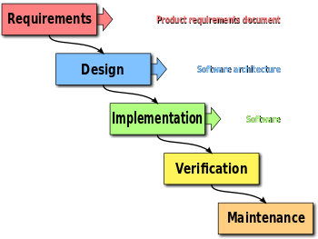
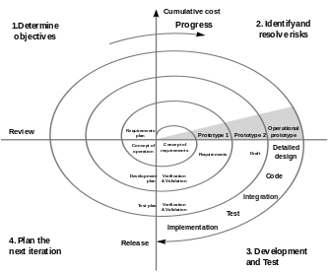
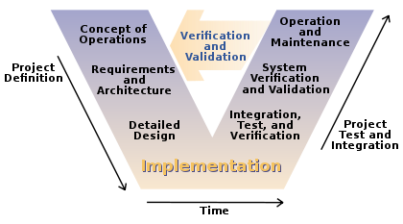
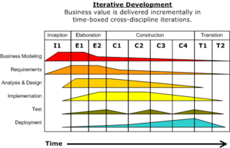
Traditional Methodologies
3
1
4
2

Slide 5
Problems with Traditional Model
Requirements Not Clear
Fear to go to the next phase
Analysis paralysis
Change gets more and more expensive
Customers don’t get what they want
Project Takes Too Long
34% of projects delivered successfully
Long duration defers revenue
Time Wasted on Junk
52% of requirements implemented
64% of functionality rarely used
Requirements needs to be frozen before we proceed to design
Business demands faster time to market to achieve first mover advantage
Many things are done which are not directly linked with Software to be delivered
Source: Standish Report 2003

Slide 6
Getting To “Done” – Not a Good Way
ANALYSIS
DESIGN
CODE
TEST
S P R I N T
Project Timeline

Slide 7
Getting To “Done” – A Good Way
ANALYSIS
CODE
TEST
DESIGN
S P R I N T
Iteration

Slide 8
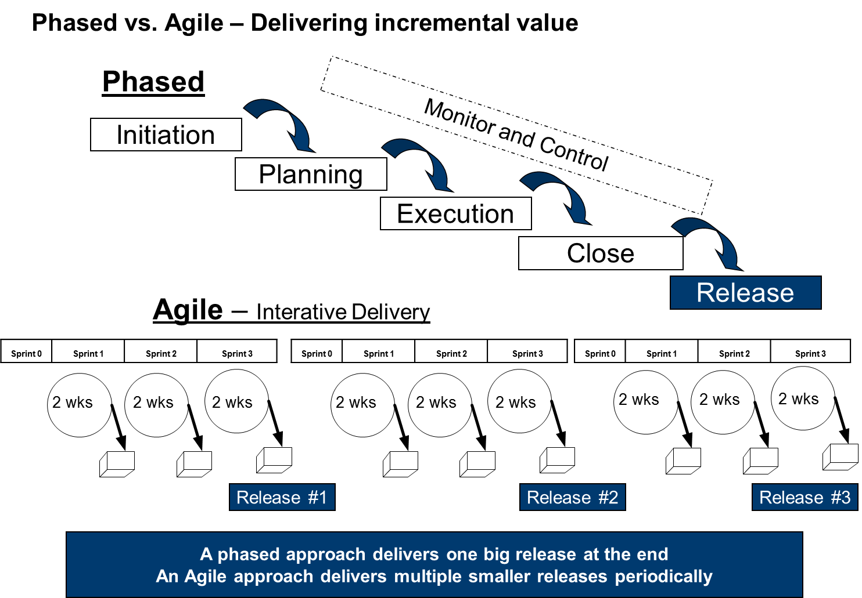

Slide 9
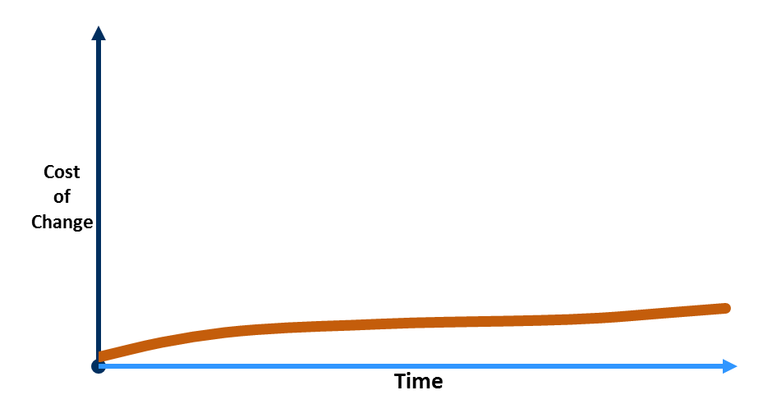
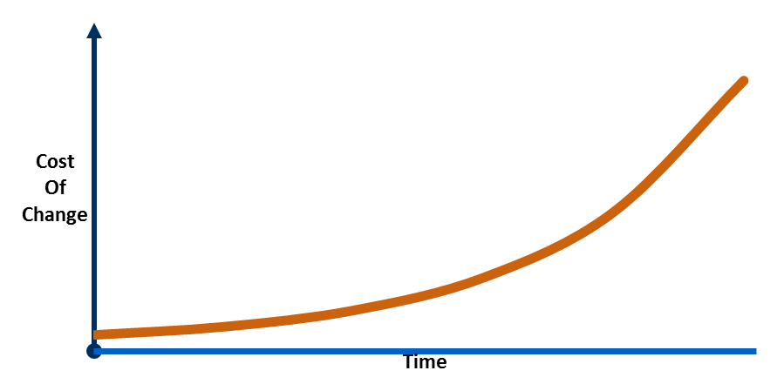
Traditional Vs Agile
Traditional: Independent functional groups
Requirements
Business Requirements
Technical Requirements
Analysis & Design
System Specifications
Component Specifications
Code
C#, C, C++ etc.
Test
Deploy
Big-Bang Integration
Validation Tests
Verification Tests
BA’s
Tester
Dev
Iteration 1
Requirements
Analysis & Design
Code
Test
Requirements
Analysis & Design
Code
Test
Deploy
Iteration 2
Requirements
Analysis & Design
Code
Test
Iteration 3
Requirements
Analysis & Design
Code
Test
Iteration 4
Agile: Works as one team
Domain
Expert
Programmer
Tester

Slide 10
Project Constraints
Traditional Approach
Agile Approach
Quality
Scope
Cost
Time
Quality
Scope
Cost
Time
Fixed
Variable

Slide 11
Backlog
WIP
Done
1. Why Agile?
2. What is Agile?
3. Know SCRUM...
4. Doing Agile

